Slide 1
TITLE : IoT Based Wireless Smart Board
Under the Guidance of:
Department of ISE
Acharya Institute Of Technology
Project Team Members:
Batch No: 5
Pravesh Kasaundhan (1AY15IS072)
1

Slide 2
Agenda
2
Abstract
Introduction
Problem Statement
Proposed System
Methodology
Requirement Specification
Design
Implementation
Snapshots
Testing
Application
Conclusion
Future Enhancements
References

Slide 3
Abstract
3
Digital display board is a common sight today. Advertisement is going digital in recent days. The use of digital display boards are seen at railway station, bus stands, educational institutions and public places.
If the user wants to change the message it needs to be done using a computer and hence the person needs to be present at the location.
Digital smart board overcomes these drawbacks by the usage of new technologies like IoT, Raspberry Pi, wireless networks and cloud in a smarter way.

Slide 4
Introduction
4
Digital smart board is an automatic self enabled, highly reliable wireless electronic board. The information can be text, pdf, images and video. It makes use of a mini computer, which is commonly termed as Raspberry Pi. It aims at designing a LED Monitor based message display controlled through a laptop.
The key technology used in developing the system is IoT, where many smart objects like Raspberry Pi & Laptop are connected through Wi-Fi.

Slide 5
Problem statement
The low range & low bandwidth of GSM technology with the use of old languages and uneconomic software in the existing system.

Slide 6
Proposed System
This project aims to increase the bandwidth and range of the system by using Wi-Fi and Web based application with Raspberry Pi. The project also increases the usability of electronic notice boards, dealing with wireless reception and display of messages. It is a LED based message display board controlled through a laptop. It is simple, easy to install and user-friendly.

Slide 7
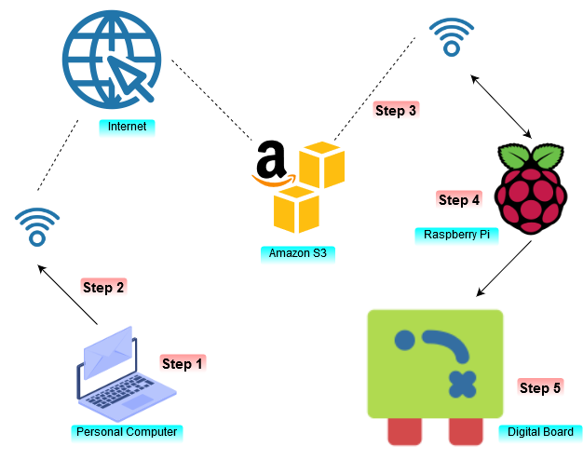
Methodology

Slide 8
Cont’d
Step1: Open the bitwise SSH client and enter IP address of the raspberry pi along with the username and password of the pi. In case of wrong credentials Error message will be displayed.
Step 2: After successful login open webpage using ip address with the port number in the format ipaddress: portnumber and the home page will appear in which the user can upload the files to be displayed on the digital board.

Slide 9
Cont’d
Step 3: After successful upload S3 bucket will be created and the data will be stored on the cloud and a copy of the data will be send to the pi.
Step 4: After receiving the data, Raspberry Pi will send the data to the digital board through the HDMI cables.
Step 5: The Digital board will receive the data from the Raspberry Pi through the HDMI port and the same will be displayed on the board.

Slide 10
Requirements
Hardware
Raspberry Pi
Display Board
Laptop
Micro SD Card
5V 2A AC-DC Adaptor
Software
Raspbian OS
Bitwise SSH client
Web Application
S3 Bucket

Slide 11
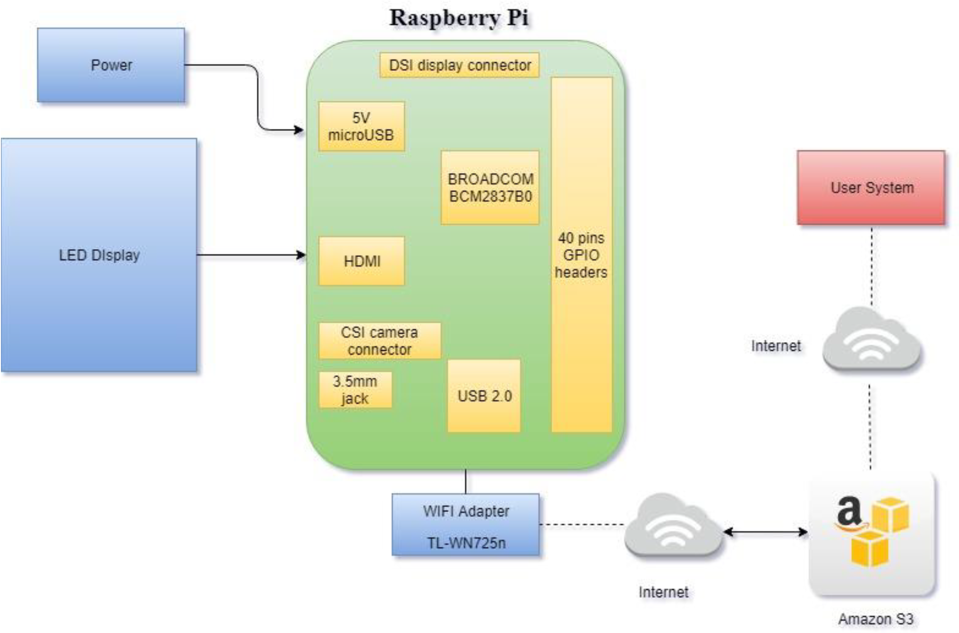
Design

Slide 12
Implementation
Raspberry Pi
The Raspberry Pi is a series of small single-board computers. The Raspbian OS is used to operate the Raspberry Pi. The configuration is done using Python libraries.
Python
Python is an interpreted, high-level, general-purpose programming language. Its language constructs and object-oriented approach aims to help programmers write clear, logical code for small and large-scale projects.

Slide 13
Cont’d
S3 Bucket
Amazon S3 is cloud storage service by AWS. In terms of implementation, buckets and objects are resources, and Amazon S3 provides APIs for you to manage them.
Flask
Flask is a micro web framework written in Python. It is classified as a micro framework because it does not require particular tools or libraries. It has no database abstraction layer and form validation.

Slide 14
Cont’d
Boto3
Boto3 is the Amazon Web Services (AWS) SDK for Python. It enables Python developers to create, configure, and manage AWS services like S3.
FBI
Frame Buffer Image Viewer (FBI) is used for image rendering. It displays the specified file on the console using the framebuffer device.

Slide 15
Cont’d
Omx player
Omxplayer is a video player specifically made for the Raspberry Pi's GPU. It relies on the OpenMAX hardware acceleration API, which is the Broadcom's VideoCore officially supported API for GPU video/audio processing.
Bashrc
The bashrc file is a shell script which runs every time a user opens a new shell. The bashrc file is commonly used to set aliases to commonly used commands so that you don't have to remember long commands.

Slide 16
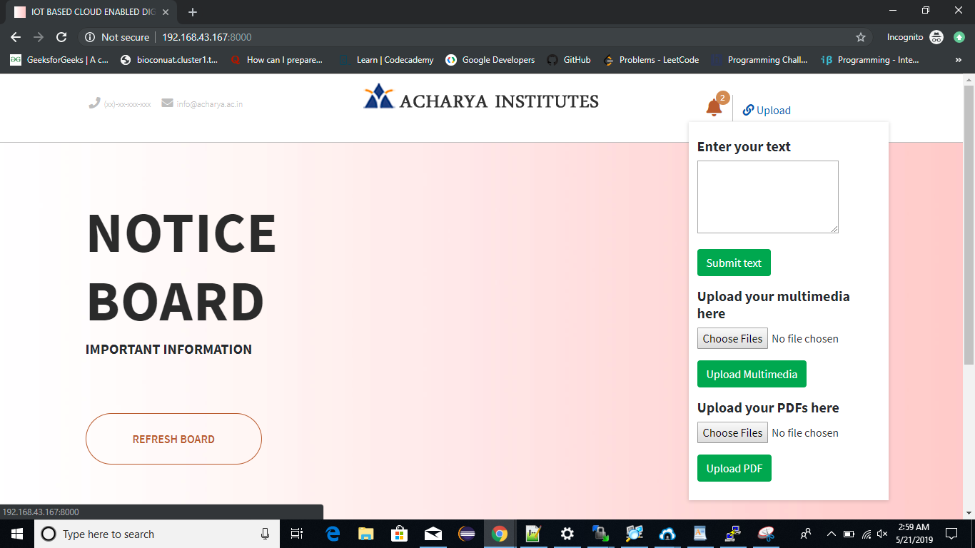
Snapshots
Web page from which the client can upload the data such as Text, Images, PDF and Video.

Slide 17
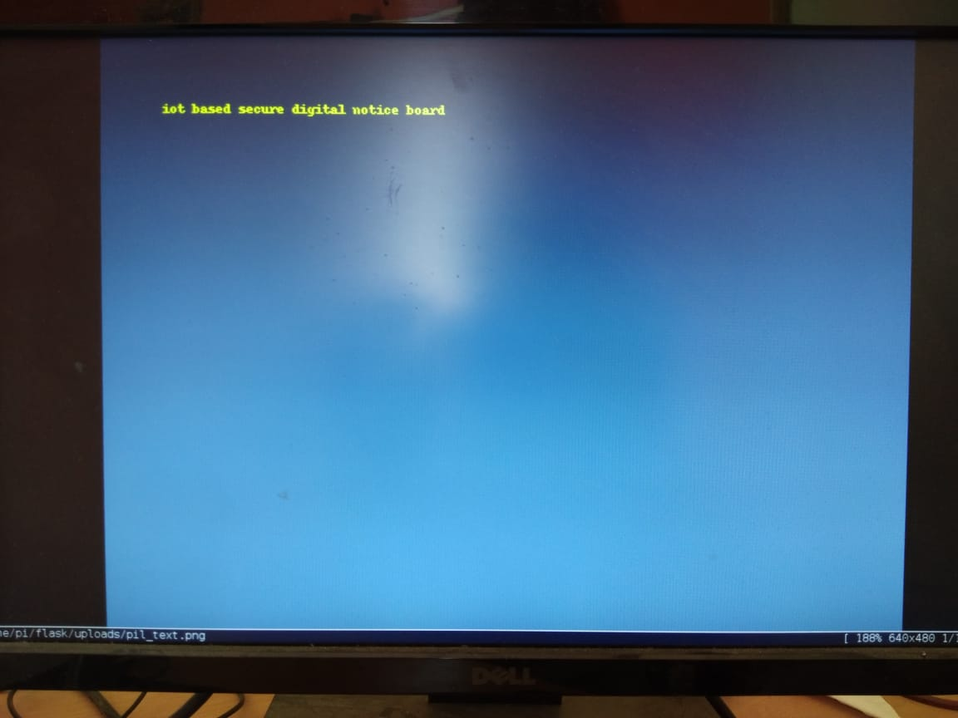
Cont’d
Displaying text on the Screen

Slide 18
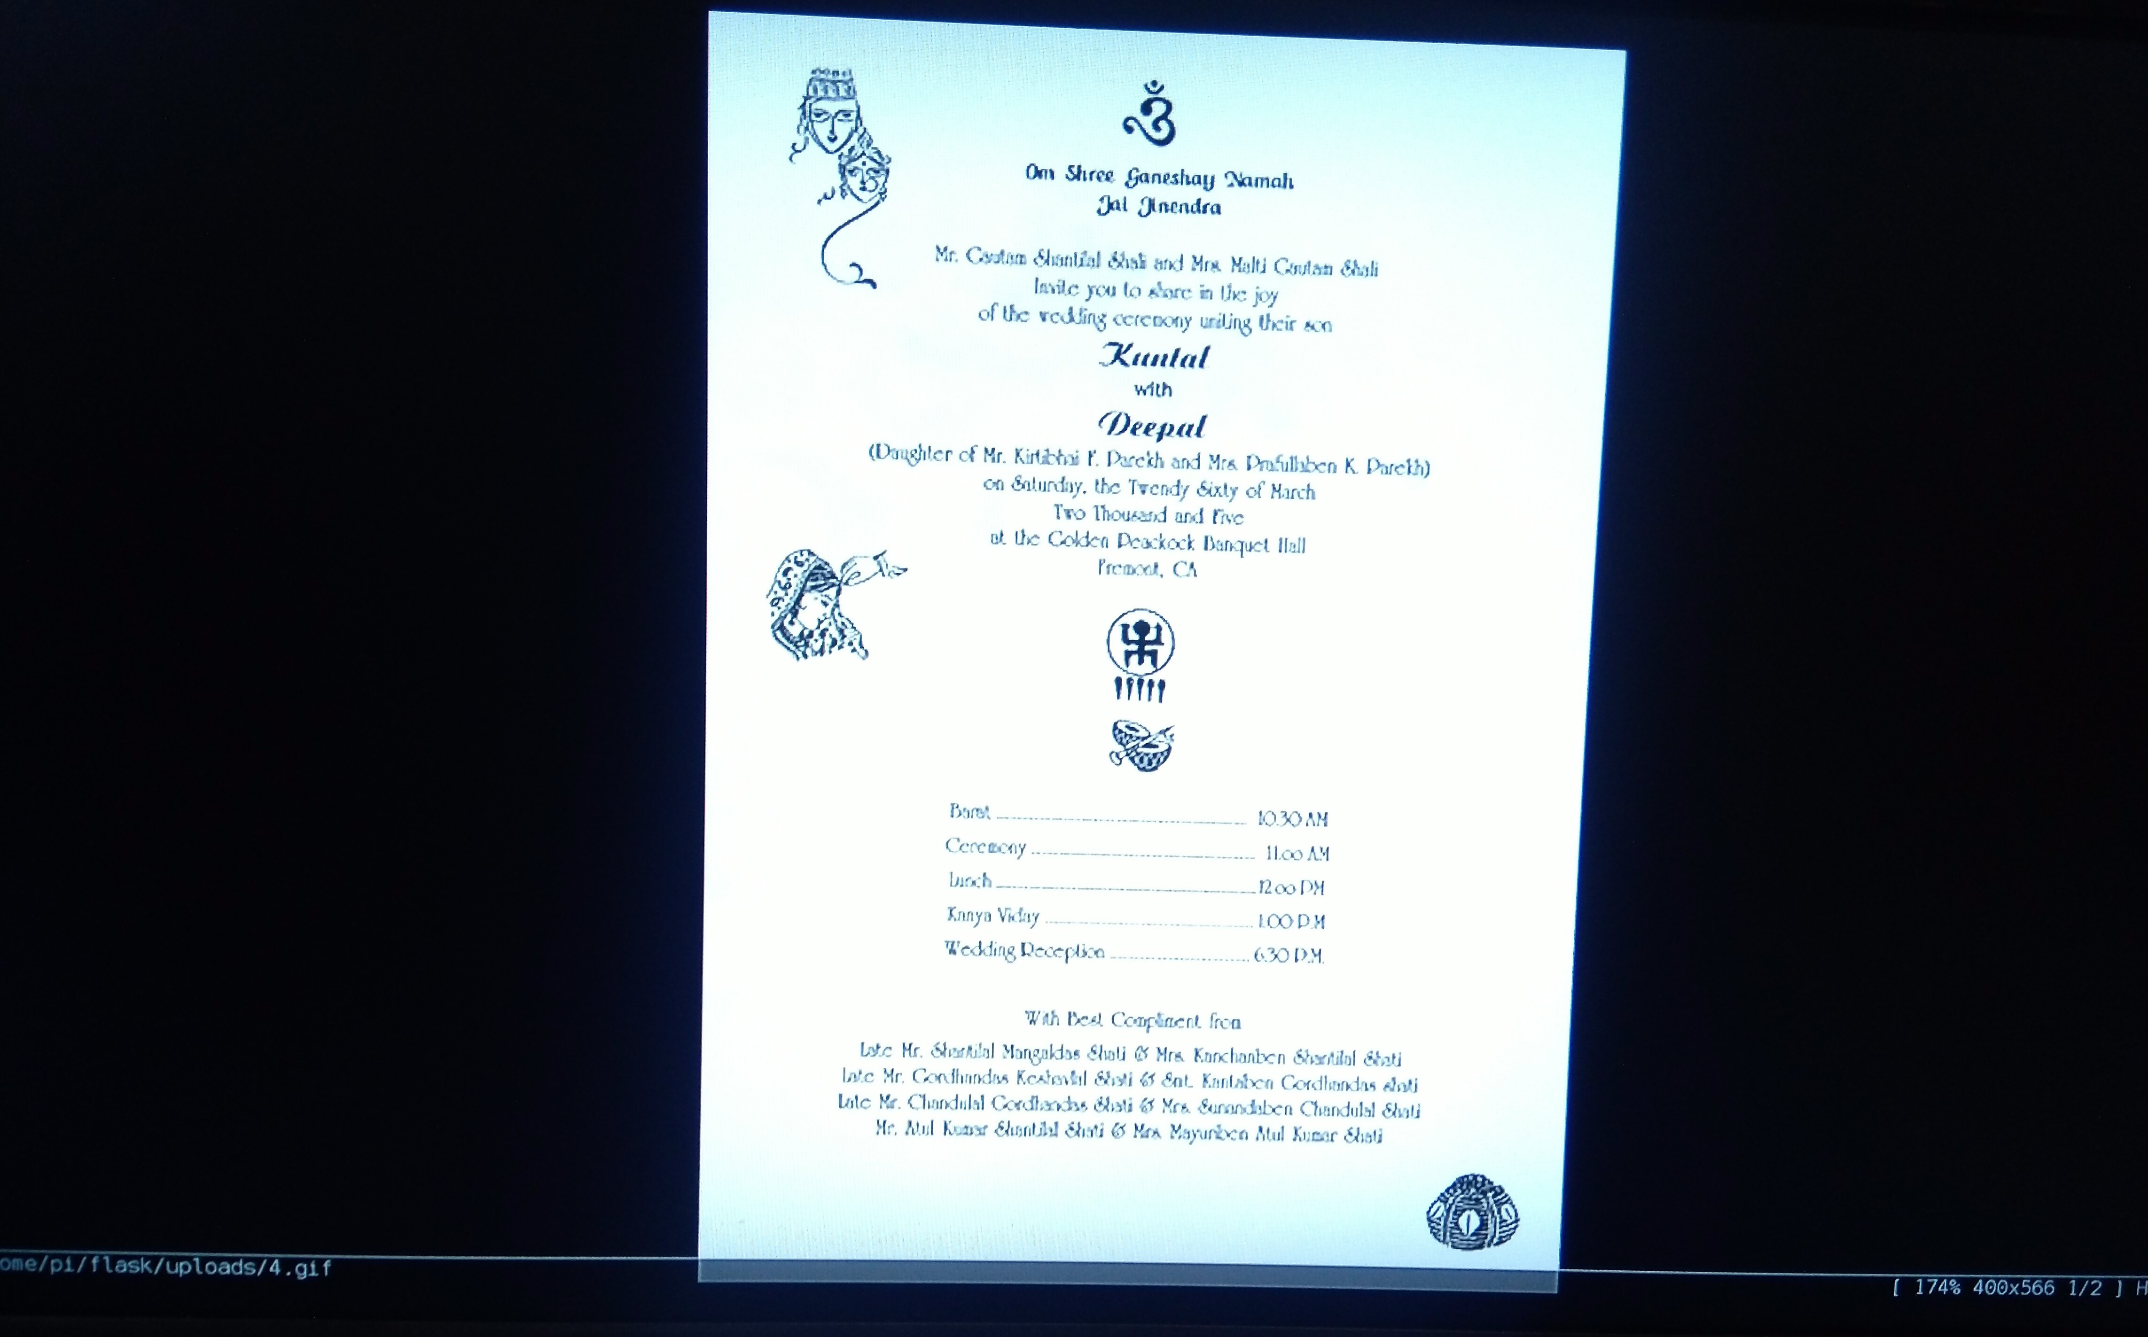
Cont’d
Displaying Image on the Screen

Slide 19
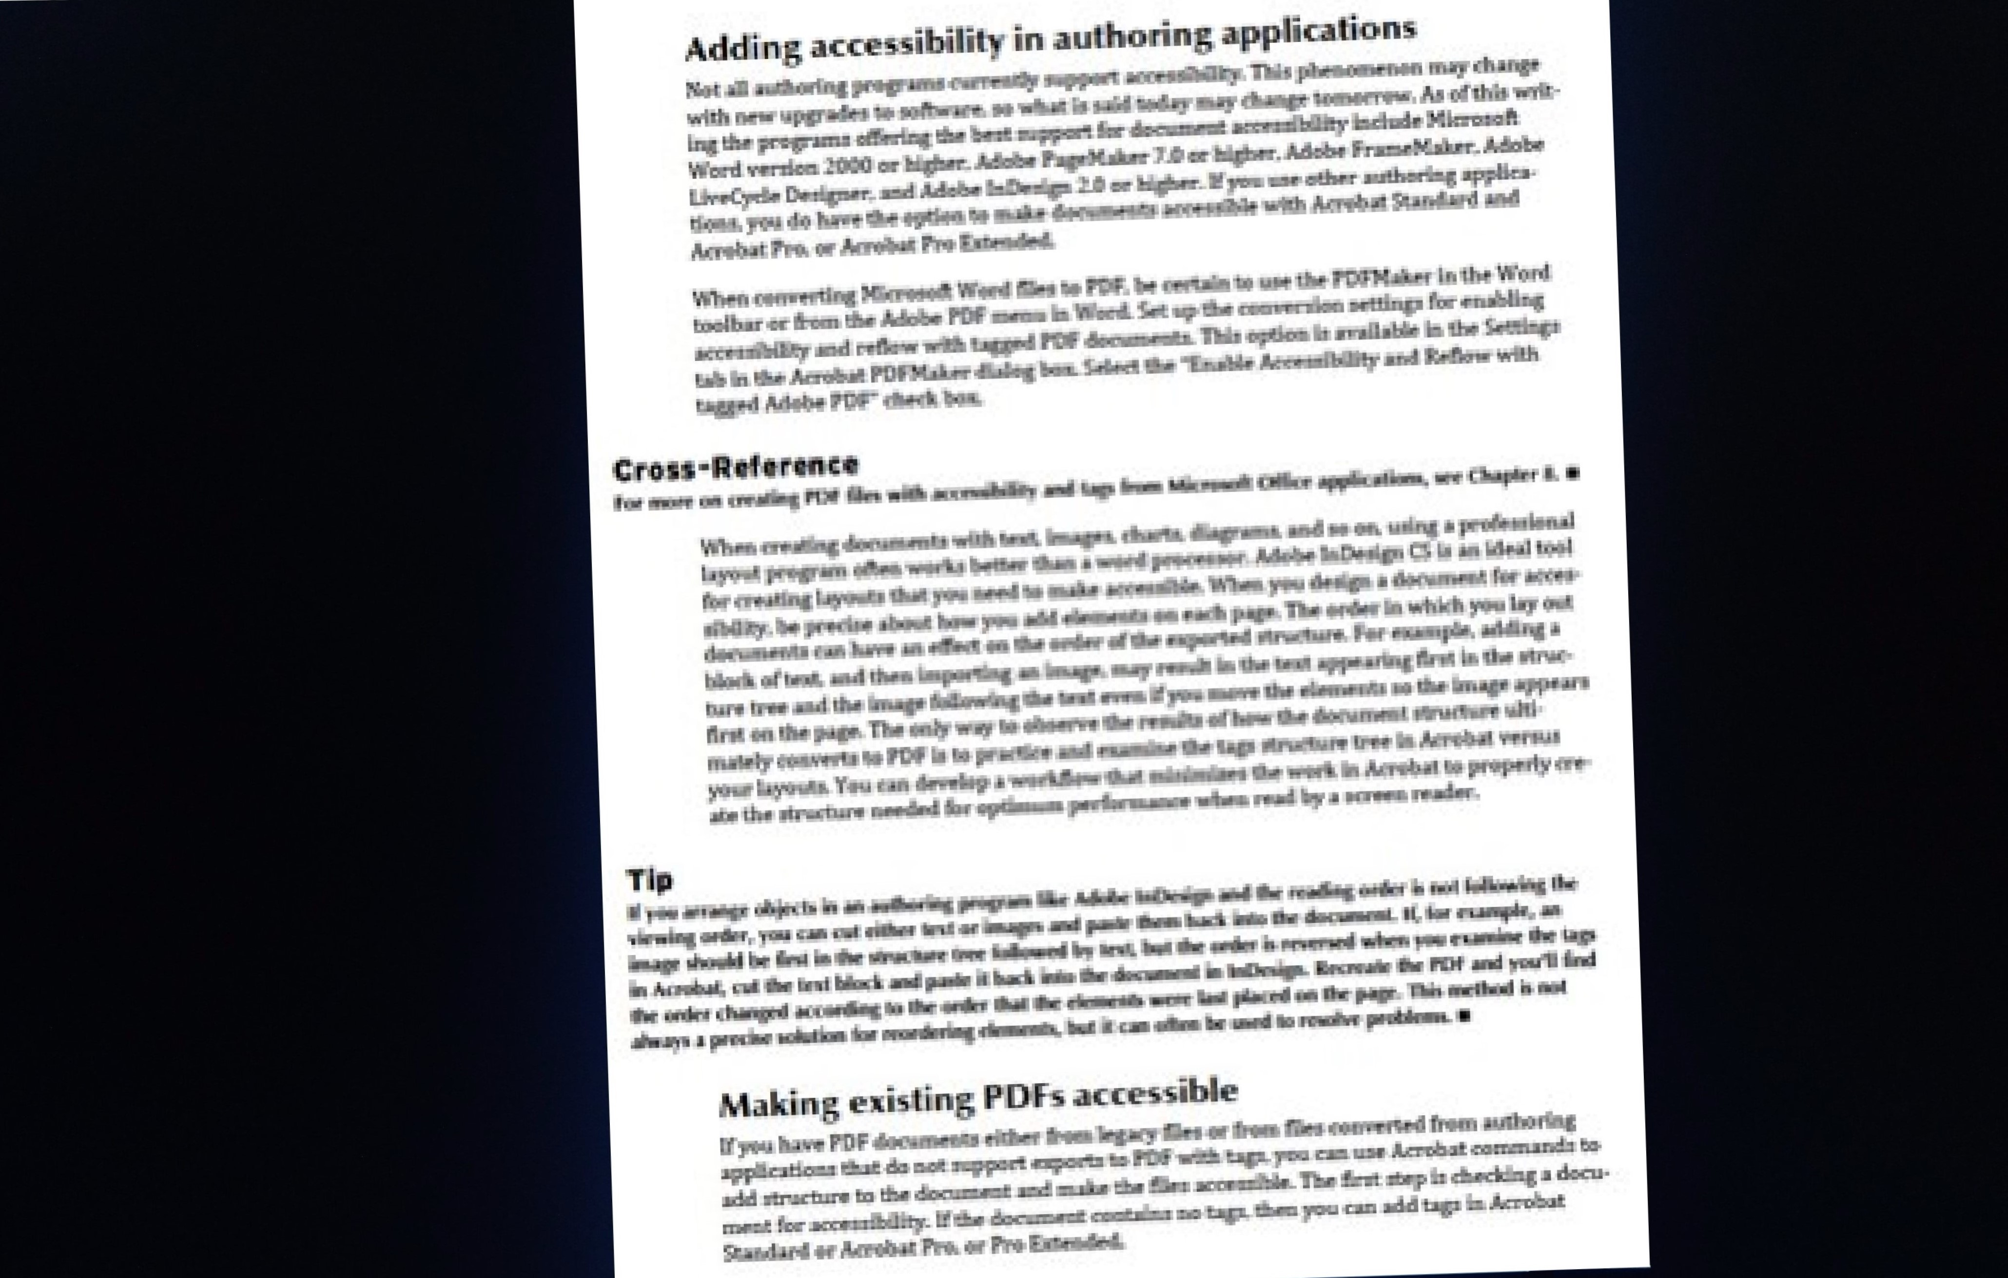
Cont’d
Displaying PDF on the Screen

Slide 20
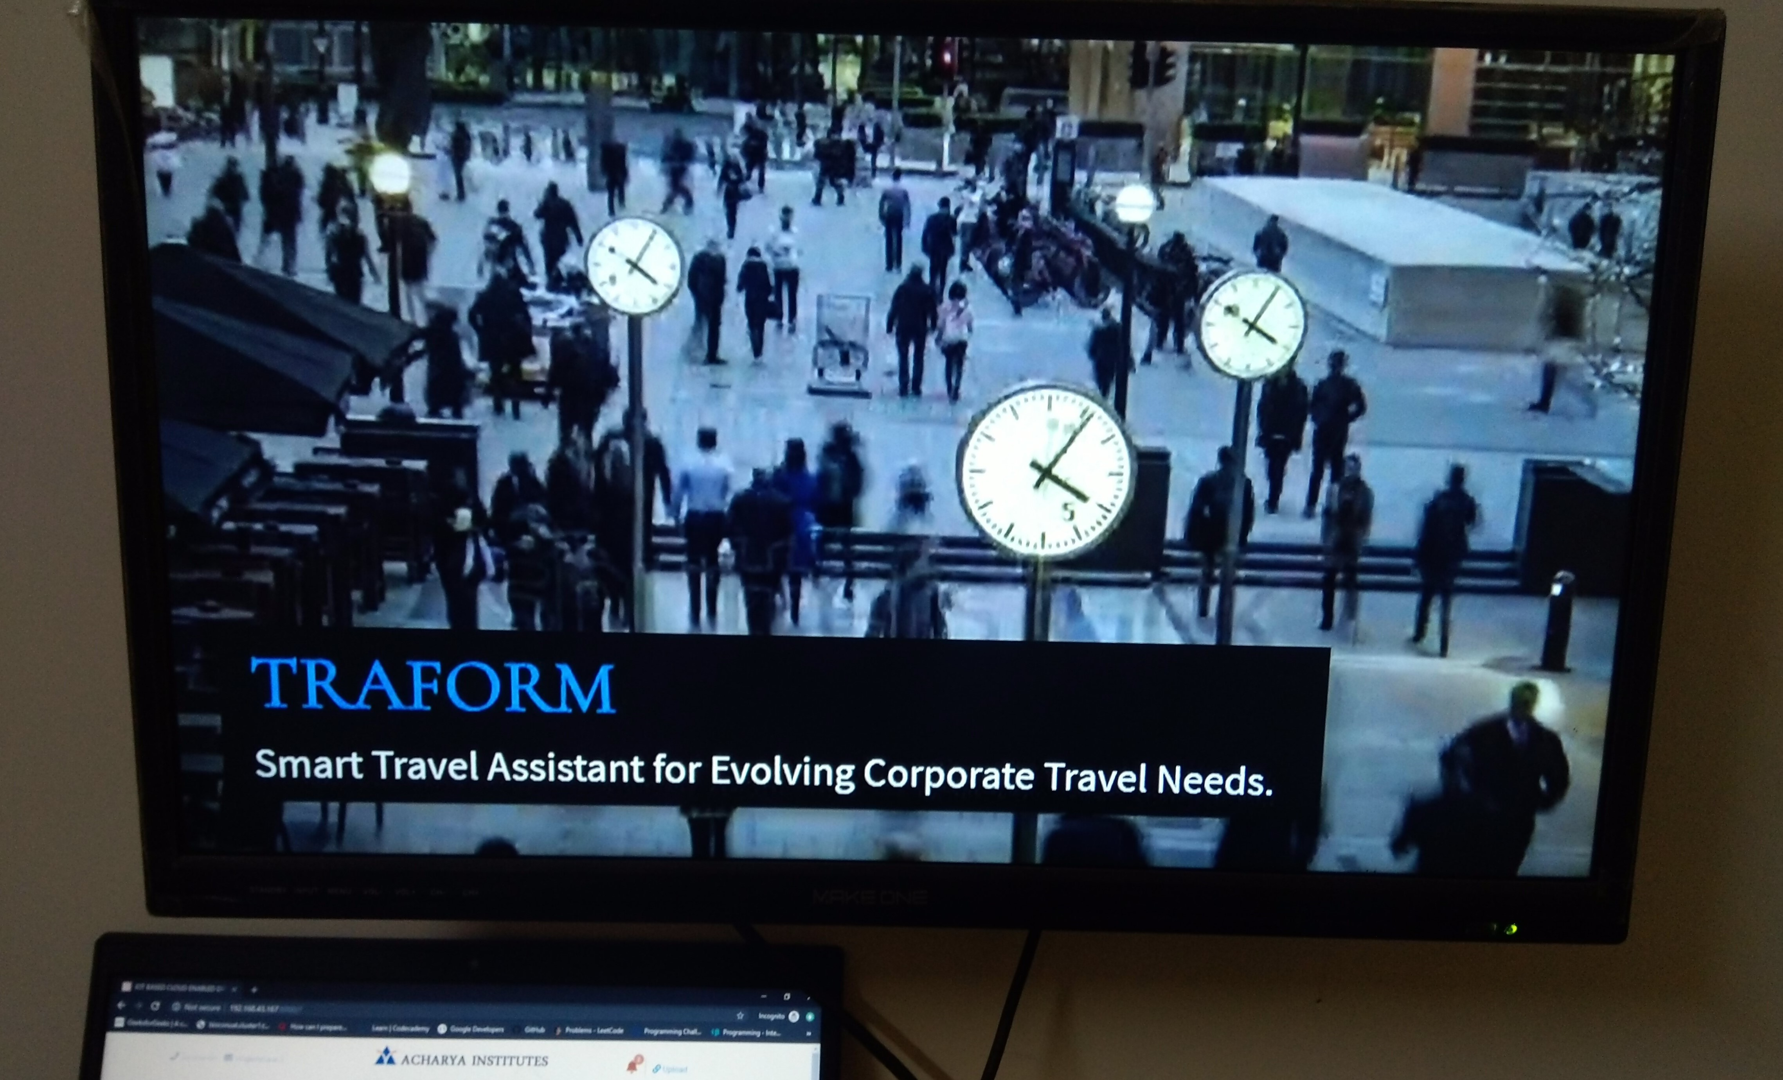
Cont’d
Displaying Video on the Screen

Slide 21
Testing
Unit Testing
Unit Testing is defined as a type testing where individual units are tested.
Sl. No | Description | Input | Expected Output | Actual Output | Status
1 | Checking if Raspberry Pi works | Power Supply | Red light Indicator should glow | Red light Indicator glowing | Pass
2 | To check whether Raspbian OS is Installed Successfully | Insert bootable SD card | Dashboard should appear | Dashboard appeared | Pass

Slide 22
Cont’d
Sl. No | Description | Input | Expected Output | Actual Output | Status
3 | Function to test upload_file | File with invalid extension | Uploading should fail | Successfully Uploaded | Fail
4 | Function to test upload_file | File with valid extension | Should Successfully Upload | Successfully Uploaded | Pass
5 | Function to test reboot | Click the refresh notice board button | Home screen should appear | Home screen appeared | Pass

Slide 23
Integration Testing
Integration testing is a type of testing where individual units are combined and tested as a group.
Sl. No | Description | Input | Expected Output | Actual Output | Status
1 | Integrate PC & RPi for Authentication | Input Login Id & Password | Should securely login using SSH protocol | Secured remote login successful | Pass
2 | Integrate Web App & RPi to check web page | Provide IP add and Port num in browser | Browser should load the web page | Web page loading | Pass

Slide 24
Cont’d
Sl. No | Description | Input | Expected Output | Actual Output | Status
3 | Integrating RPi & Board to push data into display | Push invalid data from Raspberry Pi to board | Should not display data on Board | Data displayed on Board | Fail
4 | Integrating RPi & Board to push data to display | Push valid data from Raspberry Pi to board | Should display data on Board | Data displayed on Board | Pass

Slide 25
System Testing
System testing is a type of testing where all units are combined and tested as a system.
Sl. No | Description | Input | Expected Output | Actual Output | Status
1 | Collect text message from user | Input text message into the dialog box | Should allow the user to enter text message | User allowed to enter text message | Pass
2 | Display the text message | Send the text message to the Raspberry Pi | Should convert the message into .jpeg format and display on the screen | Message converted into .jpeg format and displayed on the screen | Pass

Slide 26
Cont’d
Sl. No | Description | Input | Expected Output | Actual Output | Status
3 | Collect image message from user | Select the image from the system | Should allow the user to browse any image file. | User allowed to browse any image file. | Pass
4 | Display image | Send the image to the Raspberry Pi | Should load image and display on the screen | Image loaded and displayed on the screen | Pass

Slide 27
Application
This system will help in reducing human efforts and risks involved.
We can use multiple screens for displaying the big size advertisements.
We can use this system at various places like colleges, subways, shopping malls, schools and hospital for visitors.
We can use this system at critical places where people can not reach normally.

Slide 28
Conclusion
The GSM based notice board was inefficient, complex, costly and had limited range. Use of internet, IoT devices, Cloud services, Wireless technology and Username-Password system provides faster transmission of data over mobile devices. It saves time, cost of cabling, and size of the system.

Slide 29
Future Enhancement
The proposed system can further be extended to display the data worldwide with the use of dedicated Server and dedicated Platform.
There can be a dedicated Android application for clients. Which will help them upload, update and monitor their data on the go.

Slide 30
References
Large Screen Wireless Notice Display System by Yash Teckchandani, G. Siva Perumal, Radhika Mujumdar, Sridhar Lokanathan [June 2015].
GSM Based Wireless Electronic Notice Board Display through ARM7 and LED by P. Sampath Kumar, V. Priyanka, Lakshmi Surekha, Y. Harish Reddy [May 2016].
Wireless Electronic Notice Board Using Raspberry Pi 3. by Er. G. Jalalu, Er. Polepogu Rajesh [June 2017].
An IOT Based Web Page Controlled Digital Notice Board by P. Bhaskara Chary, Dr. T. Srinivasulu [August 2017].
IoT based web-controlled notice board by Divyashree M, Harinag Prasad S, Sandeep G T, Bhavya S N, Poornima S [April 2018].

Slide 31
Cont’d
www.python.org for details on python programming.
www.raspberrypi.org for details on Raspberry Pi.
www.raspbian.org for details on Raspbian OS.
www://aws.amazon.com/s3/ for S3 Bucket.

Slide 32

Questions?

Slide 33


